Slide 1
The IT companies
in Cambodia
CHAPTER 2 : EXPLORE THE IT INDUSTRY

Slide 2

OBJECTIVES FOR THIS SESSION
Evaluate your understanding of the IT vocabulary
Apply your online searching skills
Explore the different IT companies in Cambodia
Select the companies you would like to visit

Slide 3


Vocabulary time!
ENGAGE
10 MIN
Engage : "Let's see how well you know these vocabulary words! I'll give you a definition, and you have to guess the word. The first person to get 10 correct wins!"

Slide 4



EXPLAIN
The goals of a company visit
10 MIN
Get to know
a company
Get information
about a career
Get information
about a job
Presentation of the company
Tour of the company
Meet employees from specific department
Ask questions about career
Job shadowing
Ask questions about daily professional life

Slide 5

EXPLAIN
Overview of the research project
15 MIN
Jul
Aug
Sept
Oct
Nov
C1- Know
yourself
C2- Explore the IT industry
C3- Perform a career exploration

Slide 6


Process of the company visits
Explore the IT industry
Perform a career exploration
Jul
Aug
Sept
Oct
Nov
Presentation of the companies
Contact the companies
Group research
Organize company visits
Visit 2 companies
Support from PNC

Slide 7

Presentation of the companies
Select three companies you want to visit
Present the companies: you will have 7 minutes + 3 minutes for questions
Explain why you want to visit those companies: how does the company match your interests, which positions are you interested in?
Convince the jury why PNC should help you visit those companies
The jury: PL trainer, WEP trainer, External relations officer

Slide 8

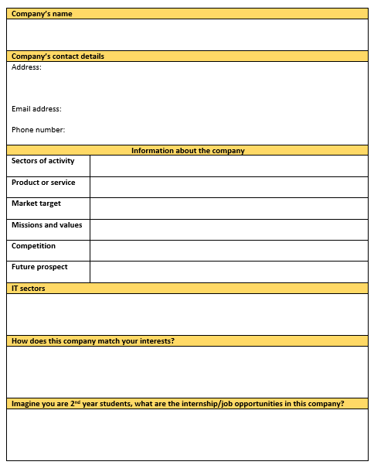
Online research of the companies
ACTIVITY
60 MIN
In group, fill the file, prepare your oral presentation.
You have 3 sessions to have your presentation ready:
- Speech: 7 minutes, 1 or 2 speakers, slides
- Questions from the jury: 3 minutes
The jury (PL, IT, ERO) will judge how convincing you are and if the companies match your interest and your career after PNC.

